Slide 1

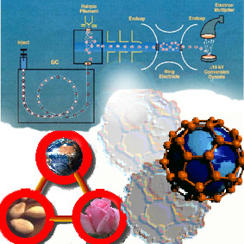
ChE 257
Analytical Chemistry
E.G. Ankudey, PhD
Dept of Chemical Engineering, KNUST

Slide 2
Course Content
Gravimetry analysis
Volumetric analysis (titrimetry): equivalence-point, end point, standard solutions, indicators, errors, statistics: acidimetry and alkalimetry; complex formation reactions; precipitation reactions; redox reactions
Instrumental Methods; signal-to-noise ratio, sensitivity and detection limit, errors, analytical curve, standard addition, internal standard method
Electroanalytical methods: potentiometry; polarography
spectroanalytical methods; spectrophotometry. atomic spectroscopy. flame spectrometry.
Separative techniques: GLC, HPLC.

Slide 3


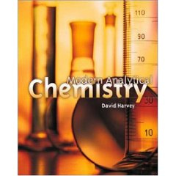
References
Fundamentals of Analytical Chemistry
8th Edition, © 2004
Douglas A. Skoog , Donald M. West, F. James Holler Stanley R. Crouch
Vogel’s Quantitative Chemical Analysis
6th Edition, © 2000
J. Mendham , R.C. Denney , J. D. Barnes M.J.K. Thomas
Modern Analytical Chemistry
© 2000
David Harvey

Slide 4
Course organisation
3 hours regular lectures per week
1 hour tutorial session per week or as needed
8-12 homework assignments (10-20%)
2 mid semester exams (10-30%)
Final exam (50-70%)
Office hours: Open door policy (feel free to walk in)
TA: Mr. Joseph Amoah

Slide 5
Course objectives
At the end of the course, students
will acquire basic concepts, principles, and techniques of
modern analytical chemistry
will be empowered with an analytical mindset and the
abilities to solve diverse analytical problems in an efficient and quantitative way that conveys the importance of accuracy and precision of the analytical results.

Slide 6

Introduction
Chemistry (kem'is tree): noun.
The science in which substances are examined to find out what they are made of, how they act under different conditions, and how they are combined or separated to/from other substances.
In other words, chemistry deals with finding what different substances are made of, what kind of transformations take place, and different chemically related facts about a certain organism or substance.

Slide 7

Introduction

Slide 8
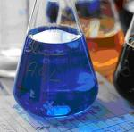
What is Analytical Chemistry ?
Analytical chemistry deals with separating, identifying, and quantifying the relative amounts of the components of an analyte.
Analyte = the constituent of interest in a sample; the component(s) of a sample that are to be determined.

Slide 9
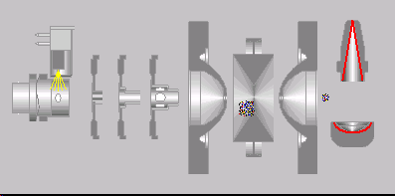
What is analytical chemistry ?
Qualitative analysis :
What is present ?
Determination of chemical identity of the species in the sample.
Quantitative analysis :
How much present ?
Determination of the amount of species or analytes, in numerical terms. Hence, math is heavily involved. In order to perform quantitative analysis, typically one needs to complete qualitative analysis. One needs to know what it is and then select the means to determine the amount.
Instrumental analysis

Slide 10
The role of analytical chemistry:
central science
Chemistry : Biological, Inorganic, Organic, Physical
Physics : Astrophysics, Astronomy, Biophysics
Biology : Botany, Genetics, Microbiology, Molecular biology, Zoology
Geology : Geophysics, Geochemistry, Paleontology, Paleobiology
Environmental science : Ecology, Meteorology, Oceanography
Medicine : Clinical, Medicinal, Pharmacy, Toxicology
Material science : Metallurgy, Polymers, Solid state
Engineering : Civil, Chemical, Electronical, Mechanical
Agriculture : Agronomy, Animal, Crop, Food, Horticulture, Soil
Social Science : Archeology, Anthropology, Forensics
Analytical
chemistry

Slide 11
Several different areas of analytical chemistry
Clinical analysis - blood, urine, feces, cellular fluids, etc., for use in diagnosis.
Pharmaceutical analysis - establish the physical properties, toxicity, metabolites, quality control, etc.
3. Environmental analysis - pollutants, soil and water analysis, pesticides.
4. Forensic analysis - analysis related to criminology; DNA finger printing, finger print detection; blood analysis.
5. Industrial quality control - required by most companies to control product quality.
6. Bioanalytical chemistry and analysis - detection and/or analysis of biological components (i.e., proteins, DNA, RNA, carbohydrates, metabolites, etc.).
This often overlaps many areas.
Develop new tools for basic and clinical research.

Slide 12
Classification of Quantitative Methods of Analysis
Gravimetric Method: mass is measured.
Volumetric Method: volume is measured or used to determine amount of sample via concentration.
Instrumental Methods: use an instrumental technique to assay the amount of sample e.g. Electroanalytical based upon electron-transfer and Spectroscopy including mass spectrometry

Slide 13
Miscellaneous analytical methods
Mass spectrometry - mass-to-charge ratio of an analyte's decomposition products.
Radiochemical methods - measuring rates of radioactive decay by an analyte.
3. Kinetics - measuring reaction rates.
4. Thermal conductivity.
5. Optical activity - measuring the interactions of an analyte with plane-polarized light.
6. Refractometry / Refractive index.

Slide 14
Methods of Detecting Analytes
Physical means
mass
color
refractive index
thermal conductivity
with electromagnetic radiation (Spectroscopy)
absorption
emission
scattering
by an electric charge
electrochemistry
mass spectrometry
There are a limited number of ways to detect an analyte. However, in each of the above general categories there are a large multitude of specific analytical techniques.

Slide 15
Steps in a Typical Quantitative Analysis
1. Select a method: accuracy, reliability, time and cost, complexity of sample
e.g., blood samples, pharmaceutical products.
2. Sampling: obtaining “a representative sample”, especially important for mass products.
3. Sample preparation and handling
a) Dissolution or digestion of samples
Avoiding decomposition conditions. This is
especially troublesome for biological samples.
b) Preparation of solid samples :
Solids are usually ground to a suitable particulate
size to get a homogeneous sample.

Slide 16
Steps in a Typical Quantitative Analysis
4. Define replicate sample: accuracy, reliability and cost
5. Eliminating interferences: blank control
6. Calibration and measurement C_{A}= kX
7. Calculation and data reduction
8. Evaluating results and estimating their reliability
This requires appropriate use of statistics.
An analytical result without an estimate of reliability
is of no value.

Slide 17
Specificity and Selectivity
Techniques or reactions that work for only one analyte are said to be specific.
Techniques or reactions that apply for only a few analytes are selective.
Matrix
The matrix or sample matrix is all of the components in the sample containing an analyte.

Slide 18
What is analytical chemistry ? Summary
<Result set> = {S, [C_{i}]₁^{n}, [Q_{i}] ₁^{n}, [A_{i}] ₁^{n}, T}
where S = matrix system, C_{i} = species, Q_{i} = quantity, A_{i} = accuracy, T = time
Source : Philip Barker : Computers in analytical chemistry

Slide 19

Calculations used in analytical chemistry

Slide 20
The Metric System a. Invented by French scientists in 1795 b. Based on powers of 10 c. SI (International System of Units)
Fundamental Units
a. Time 1) Unit is the second 2) First defined as 1/86 400 of the mean solar day 3) Now defined as the frequency of a type of radiation emitted
by cesium-133

Slide 21
b. Length 1) Unit is the meter 2) First defined as one ten-millionth (10⁻⁷) of distance from
north pole to equator through Lyons, France 3) Redefined in 1960 as a multiple of a wavelength of light
emitted by krypton-86 4) Redefined again in 1982 as the distance light travels in
1/299 792 458 second in a vacuum
c. Mass 1) Unit is the kilogram 2) The only unit not defined in terms of atoms 3) It is the mass of a platinum-iridium metal cylinder kept in
Sevres, France
http://www.setterfield.org/history.htm#minimum http://www.kriss.re.kr/new2004/standard/mass_1.jsp

Slide 22
International system of unit ( Systeme International d’Unites), 1960

Slide 24
Prefix of units
Prefix | Symbol | Factor | Prefix | Symbol | Factor
Yotta | Y | 10²⁴ | Deci | d | 10^{–1}
Zetta | Z | 10²¹ | Centi | c | 10^{–2}
Exa | E | 10¹⁸ | Milli | m | 10^{–3}
Peta | P | 10¹⁵ | Micro | μ | 10^{–6}
Tera | T | 10¹² | Nano | n | 10^{–9}
Giga | G | 10⁹ | Pico | p | 10^{–12}
Mega | M | 10⁶ | Femto | f | 10^{–15}
Kilo | k | 10³ | Atto | a | 10^{–18}
Hecto | h | 10² | Zepto | z | 10^{–21}
Deca | da | 10 | Yocto | y | 10^{–24}

Slide 25
Example
590nm = 590×10⁻⁹ m = 5900 Å
20 μL = 20 ×10⁻⁶ L
6 pmol = 6×10⁻¹² mol
20Gbite = 20×10⁹ bite
1 mL = 10⁻⁶ m³ = 1cm³

Slide 26
Expression of concentration
1) Molarity :
M = (moles of solute) / (liter of solution)
= (mmoles) / (ml)
A mole is defined as the number of atoms of ¹²C in exactly 12g of ¹²C (12 amu or daltons).
Avogadro’s number = 6.0221438×10²³.
A mole of a chemical species is 6.0221438×10²³ atoms, molecules, ions, electrons, ion pairs, or subatomic particles.

Slide 27
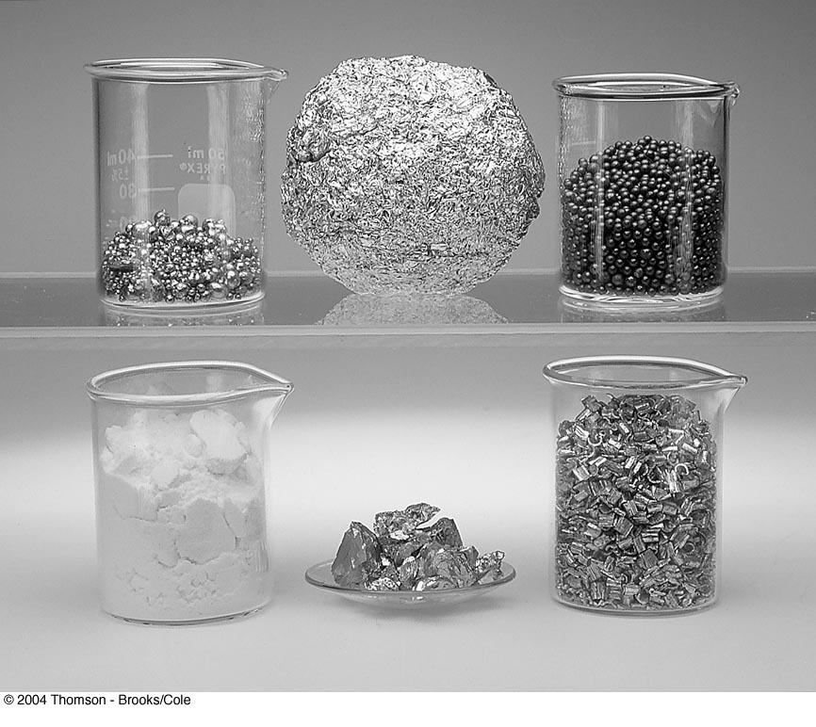
Approximately 1 mole of each of several different elements.
Clockwise from the upper left:
64 g of copper beads,
27 g of crumpled aluminum foil,
207g of lead shot,
24 g of magnesium chips,
52 g of chromium chunks, and
32 g of sulfur powder:
The beakers in the photo have a volume of 50 mL.

Slide 28
Example
Chlorine (Cl) atomic wt = 35.453
1g atom = 35.453g
wt of one Cl atom =35.453g/6.0221438×10²³
= 5.887×10⁻²³g
Cl₂ 1g molecule = 1 mol = 35.453g× 2
= 70.906g
Glucose: C₆H₁₂O₆
1M C₆H₁₂O₆ = (12.0g/mol C) × (6 mol C/mol C₆H₁₂O₆ )
+ (1.0g/mol H) × (12 mol H/mol C₆H₁₂O₆ )
+ (16.0g/mol O) × (6 mol O /mol C₆H₁₂O₆ )
= 180.0 g / mol C₆H₁₂O₆

Slide 29
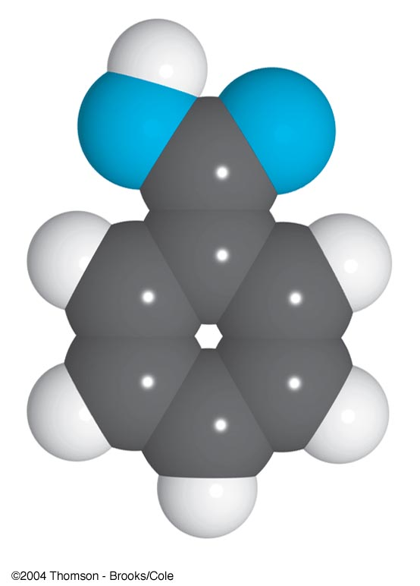
Example
Benzoic acid
C₆H₅COOH
1 mole = 122.1 g
x mole = y mmol = 2.00 g
x = 0.0164 mol
y = 16.4 mmol

Slide 30
Example
How many grams of Na⁺ (22.99g/mol) are contained in 25.0 g of Na₂SO₄ (142.0 g/mol) ?
1 mol of Na₂SO₄ contains 2 mol of Na⁺ .
Na₂SO₄ 1 mol = 142.0 g
x mol = 25.0 g x = 25.0 g / 142.0 g = ?
Na⁺ 1 mol = 22.99 g
2 x mol = y g y = 8.10 g

Slide 31
Analytical or Equilibrium
Analytical molarity is the total number of moles of a solute, regardless of its chemical state, in 1 L of solution. The analytical molarity describes how a solution of a given molarity can be prepared.
Equilibrium molarity is the molar concentration of a particular species in a solution.
Ex. 1.0 M H₂SO₄
[H₂SO₄] = 0.00 M [H⁺] = 1.01 M
[HSO₄–] = 0.99 M [SO₄^{–2} ] = 0.01 M
Analytical molarity of H₂SO₄ is given by c _{H2SO4} = [HSO₄–] + [SO₄^{–2} ]

Slide 32
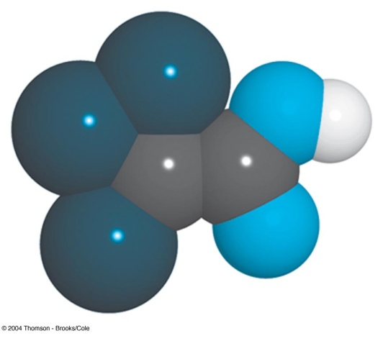
Example
Calculate the analytical and equilbrium molar concentrations of the solute species in an aqueous solution that contains 285 mg of trichloroacetic acid, Cl₃CCOOH (163.4 g/mol), in 10.0 mL (the trichloroacetic acid is 73% ionized in water).
Cl₃CCOOH = HA 163.4 g = 1 mol
285 mg = x mol x = 1.744 ×10⁻³ mol
Analytical concentration :
163.4 g / 1000 mL = 1 M
285 mg / 10.0 mL = y M y = 0.174 M

Slide 33
Equilibrium concentration:
HA ↔ H⁺ + A–
initial 1 0 0
Final 1–0.73 0.73 0.73
[HA] = y M × (1 – 0.73) = 0.174 × 0.27 = 0.047 M
[H⁺] = [A–] = y M × 0.73 = 0.127 M

Slide 34
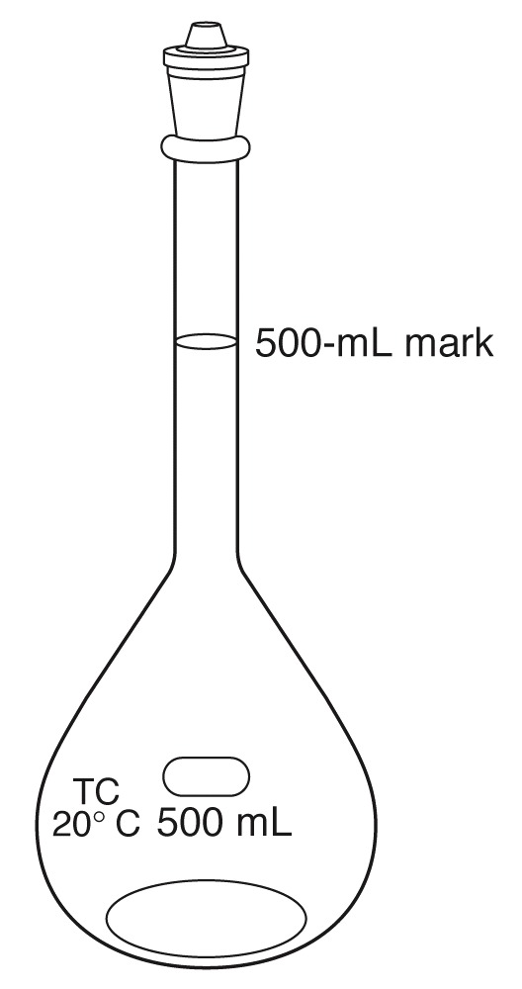
Example
Describe the preparation of 500 mL of 0.108 M BaCl₂ from BaCl₂•2H₂O (244.3 g/mol).
BaCl₂•2H₂O 1 mol ≡ BaCl₂ 1 mol
244.3 g / 1000 mL = 1 M
x g / 500 mL = 0.108 M x = 13.2 g
A volumetric flask contains a special volume
when the liquid level is adjusted to the middle
of the mark in the thin neck of the flask.

Slide 35
2) Formality ; formal or analytical concentration
F = the number of moles of a species regardless of chemical
form per liter of solution
Strong electrolyte : completely dissociated
Ex. NaCl mol wt 58.44 g/L = 1 M
2.7g/100mL sea water = x M
x = 0.46M = 0.46F
Weak electrolyte : partially dissociated
Ex. HAC 0.1 F (1.3% dissociated)

Slide 36
Normality
Normality is an older unit of concentration. It is the number of equivalents of solute per liter of solution.
The equivalent is the amount of one chemical species reacting stoichiometrically with another chemical species defined as the moles of a species that can donate one reaction unit.
Note: equivalent and normality are functions of the
chemical reaction in which the species participates.
Example: A solution of H₂SO₄
has a fixed molarity, its normality depends on how it reacts.

Slide 37
In a precipitation reaction, the reaction unit is the charge of the cation or anion involved in the reaction.
Pb²⁺(aq) + 2I–(aq) PbI₂(s)
n = 2 for Pb²⁺ and n = 1 for I–.
In an acid–base reaction, the reaction unit is the number of H⁺ ions donated by an acid or accepted by a base.
H₂SO₄(aq) + 2NH₃(aq) 2NH⁴⁺(aq) + SO₄^{2–} (aq)
n = 2 for H₂SO₄ and n = 1 for NH₃.
Normality is the number of equivalent weights (EW) per unit volume
An equivalent weight is defined as the ratio of a chemical species’ formula weight (FW) to the number of its equivalents
N = n x M

Slide 38
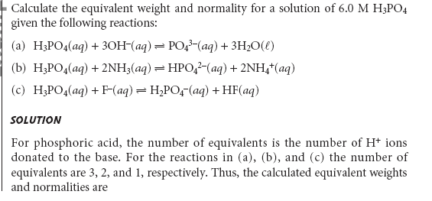
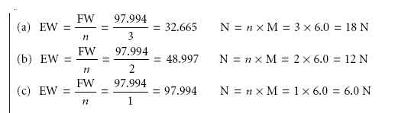
Example

Slide 39
Molality m = (mol solute) / (kg solvent)
Used in thermodynamic calculations to express concentrations that are temperature independent
4) Percent composition
% = Weight % = w/w %
= {(mass of solute) / (mass of solution)} × 100
Volume % = v/v %
= {(volume of solute) / (volume of solution)} × 100
Weight / volume percent = w/v %
= {(weight of solute, g) / (volume of solution)} × 100

Slide 40
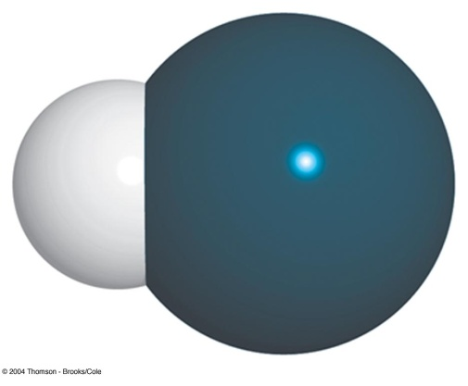
Example
Converting weight percent to molarity
37.0 wt% HCl d = 1.188 g/ml
1) Molarity ? 2) Volume of 37.0% HCl to prepare 0.1M HCl ?
HCl: 36.461 g / 1000ml = 1M
37.0g / {100g/(1.188g/ml)} = x M
∴ x = 12.0556 M ≈ 12.0556 N
MV = M’V’
12.0556N ×Vml = 0.1M ×1000ml
∴V = 8.2949 ml ≈ 8.3 ml

Slide 41
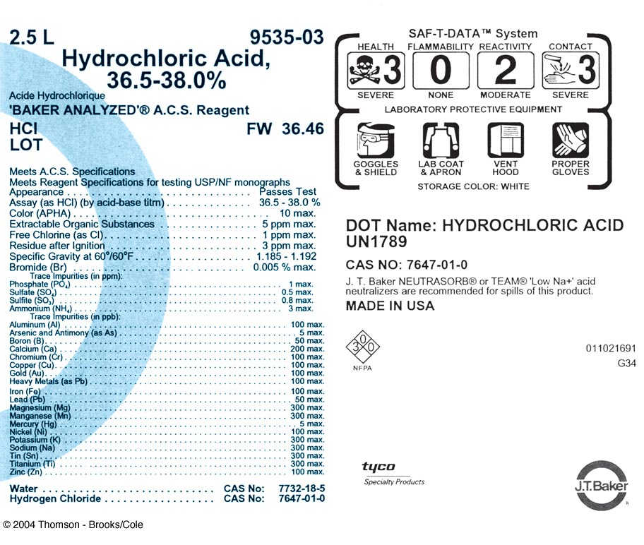

Slide 42
Parts per million
ppm = (g/g) ×10⁶ = mg/kg = μg/g
ppm (wt/v) = mg/L = μg/mL
Parts per billion
ppb = (g/g) ×10⁹ = μg/L
Parts per thousand
ppt = (g/g) ×10³

Slide 43
Osmolarity Osm = (moles of particles) / (liters of soln)
Example
5%(wt/v) Dextrose injectable fluid
C₆H₁₂O₆ = C₆H₁₂O₆
(mol wt.=180.16) 180.16g/1000mL = 1M = 1 Osm
5g/100mL = x Osm
∴ x = 0.2775 Osm
0.9%(wt/v) Saline solution
NaCl = Na⁺ + Cl⁻
m.w. 58.45 58.45g/1000mL = 1M = 2 Osm
0.9g/100mL = x Osm
∴ x = 0.308 Osm

Slide 44
p-function
The p-value is the negative logarithm (to the base 10) of the molar concentration of that species.
pX = – log [X]
Example
5.4 × 10^{–4} M HCl pH = ?
pH = – log [H⁺] = – log 5.4 × 10^{–4} =3.27
2) 2.00 × 10^{–3} M NaCl pCl = ?
pCl = – log [Cl –] = – log 2.00 × 10^{–3} =2.699
pAg = 6.372 [Ag⁺] = ?
pAg = – log [Ag⁺] = 6.372
log [Ag⁺] = – 6.372 [Ag⁺] = 4.246 × 10^{–7} ≈ 4.25 × 10^{–7}

Slide 45
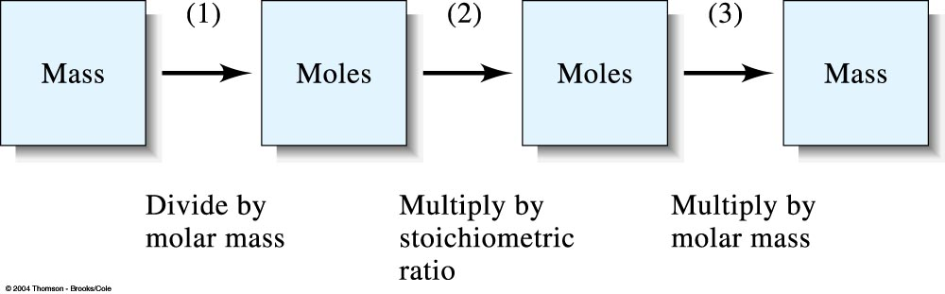
Stoichiometric calculation
Example: What mass of AgNO₃(mw=169.9) is needed to convert 2.33g of Na₂CO₃ (mw=106.0) to Ag₂CO₃ (mw= 275.7) ?
2AgNO₃ + Na₂CO₃ → Ag₂CO₃ + 2NaNO₃
AgNO₃ 2 mol = 2×169.9g ≡ Na₂CO₃ 1 mol = 106.0 g
y g ≡ x mol = 2.33g
∴ x mol = 0.02198 mol y = 169.9 g × 2 × 0.02198 mol = 7.47 g

Slide 46
Sampling, Standardization, and Calibration

Slide 47
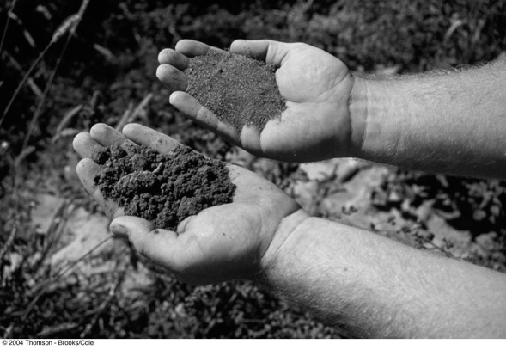

Sampling
Sampling is one of the most important operations in a chemical analysis.
Chemical analyses use only a small fraction of the available sample. The fractions of the samples that are collected for analyses must be representative of the bulk materials.
Knowing how much sample to collect and how to further subdivide the collected sample to obtain a laboratory sample is vital in the analytical process.
All three steps of sampling, standardization, and calibration require a knowledge of statistics.

Slide 48
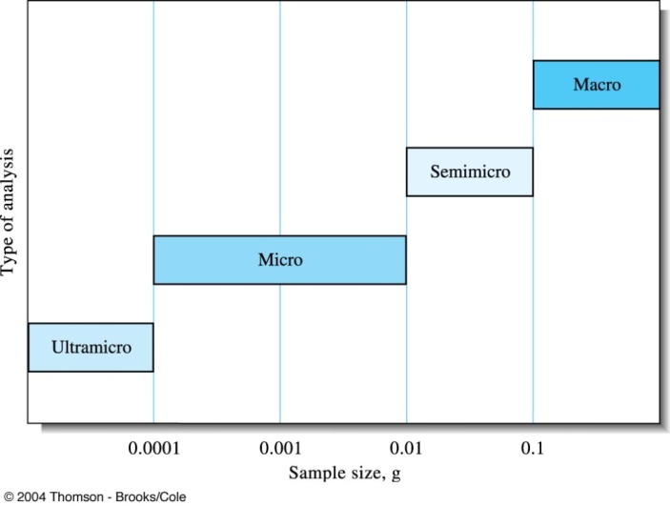
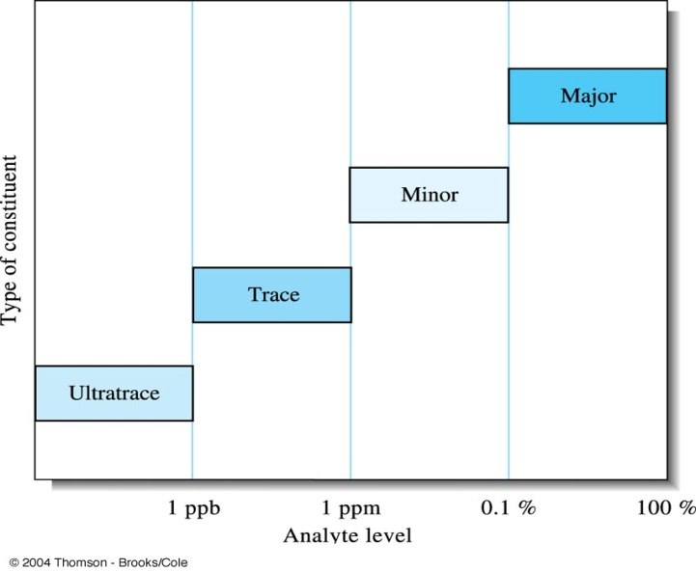
Analytical samples and methods
Sample size Type of analysis
> 0.1g Macro
0.01~0.1g Semimicro
0.0001~0.01g Micro
< 10^{–4} g Ultramicro
Analytical level Type of constituent
1%~100% Major
0.01%(100ppm)~1% Minor
1ppb~100ppm Trace
<1 ppb Ultratrace

Slide 49
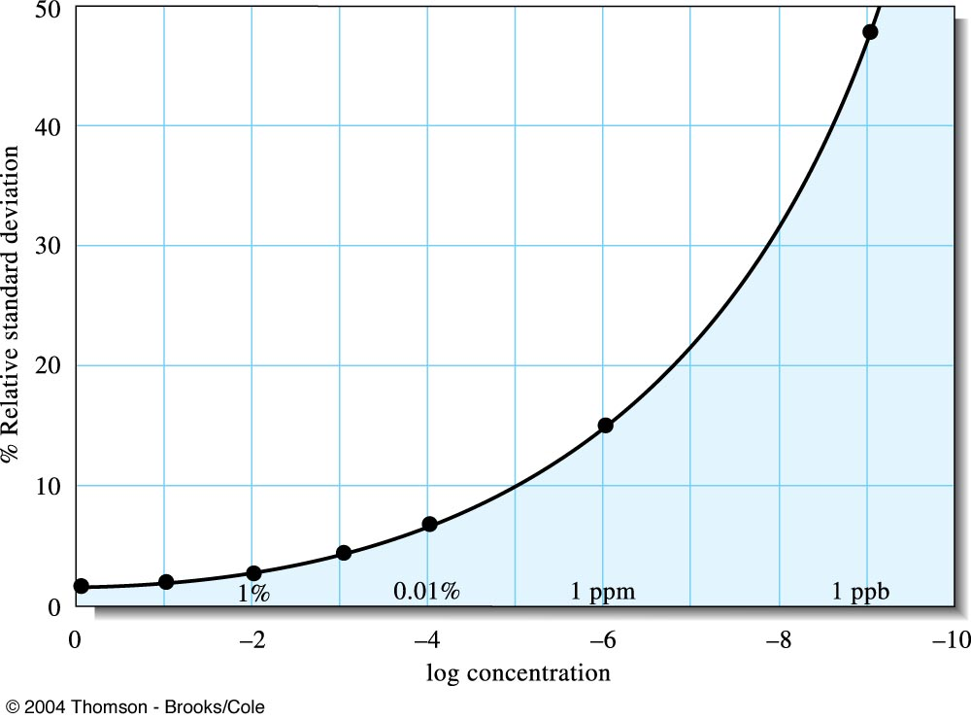
Interlaboratory error as a function of analyte concentration. Note that the relative standard deviation dramatically increase as the analyte concentration decreases.
W. Horowitz, Anal. Chem., 1982, 54, 67A-76A.

Slide 50
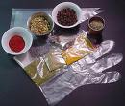
Real Samples
Matrix is the medium containing analyte.
A matrix effect is a change in the analytical signal caused by anything in the sample other than analyte.
Samples are analyzed, but constituents or concentrations are determined.

Slide 51
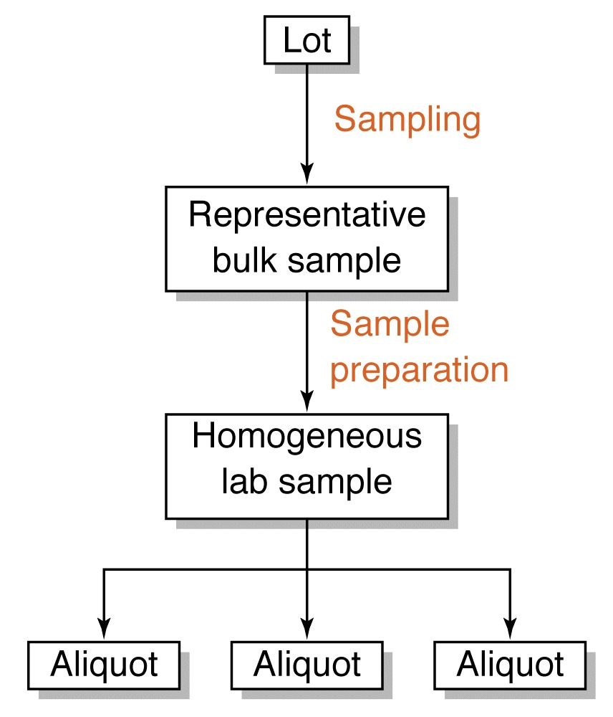
Steps in obtaining a lab sample
Identify the population
Collect a gross sample
Reduce the gross sample to a lab sample
Lab sample may constitute as little as 1 part in 10⁷ or 10⁸ of the bulk material.

Slide 52
Sampling
Sampling is the process of extracting from a large quantity of material a small portion, which is truly representative of the composition of the whole material.
Three main methods of sampling:
Census : all the material is examined ⇒ impracticable
Casual sampling on an ad hoc basis ⇒ unscientific
Statistical sampling

Slide 53
Census vs Random sampling
Census
A complete enumeration, usually of a population, but also businesses and commercial establishments, farms, governments, and so forth.
A complete study of the population as compared to a sample.
Random sampling
A commonly used sampling technique in which sample units are selected so that all combinations of n units under consideration have an equal chance of being selected as the sample.
(Statistical sampling) A sampling method in which every possible sample has the same chance of being selected.

Slide 54
Sampling statistics
Total error = sampling error + analytical error
s_{T} = ( s_{S}² + s_{A}² )^{1/2}
In designing a sampling plan the following points should be considered.
the number of samples to be taken
the size of the sample
should individual samples be analysed or should a sample composed of two or more increments (composite) be prepared.

Slide 55

Sampling uncertainties
Both systematic and random errors in analytical data can be traced to instrument, method, and personal causes.
Most systematic errors can be eliminated by exercising care, by calibration, and by the proper use of standards, blanks, and reference materials.
For random and independent uncertainties, the overall standard deviation s₀ for an analytical measurement is related to the standard deviation of the sampling process s_{s} and the standard deviation of the method s_{m} by the relationship
s₀² = s_{s}² + s_{m}²
When s_{m}< s_{s}/3, there is no point in trying to improve the measurement precision.

Slide 56
Size of the gross sample
Basically, gross sample weight is determined by
The uncertainty that can be tolerated between the composition of the gross sample and that of the whole,
The degree of heterogeneity of the whole,
The level of particle size at which heterogeneity begins.
To obtain a truly representative gross sample, a certain number N of particles must be taken. The number of particles required in a gross sample ranges from a few particles to 10¹² particles.

Slide 57
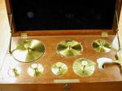
Standardization and calibration
Calibration is the process of experimentally determining the relationship between the signal and the amount of analyte. This is accomplished by the use of chemical standards.
For a total analysis method, standardization is usually defined by the stoichiometry of the chemical reactions responsible for the signal
For a concentration method, however, the relationship between the signal and the analyte’s concentration is a theoretical function that cannot be calculated without experimental measurements

Slide 58
Standardization and Calibration
Measurements with any analytical method or instrument requires calibration to ensure the accuracy of the measurement
In calibration, the goal is to ensure that the signal
measured by a piece of equipment or an instrument is correct.
There are two common calibration procedures: using a working curve, and the standard-addition method.
Both of these methods require one or more standards of known composition to calibrate the measurement
Gravimetric methods and some coulometric methods are among the few absolute methods that do not rely on calibration with chemical standards

Slide 59
Calibration methods
Comparison with standards
External standard calibration
Internal standard methods
Standard addition methods

Slide 60
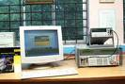
Calibration methods
The main advantage of the working curve method is that it is rapid in that a single set of standards can be used for the measurement of multiple samples.
The standard-addition method requires multiple measurements for each sample, but can reduce inaccuracies due to interferences and matrix effects.
Instrumental methods are usually calibrated with standards that are prepared (or purchased) using a non-instrumental analysis.
There are two direct analytical methods: gravimetry and coulometry. Titration is similar but requires preparation of a primary standard.

Slide 61
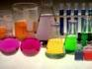
Solutions
Standard solutions
solutions containing known concentrations of analyte
Blank solutions
solutions containing all the reagents and solvents used in the analysis, but not deliberately added analyte
Solvent blank : containing the same solvent
Reagent blank : containing the solvent plus all the reagents

Slide 62
Working Curve method
The working curve is also called the calibration curve
The experimenter prepares a series of standards across the range of concentrations that are of interest
Care is taken such that these concentrations are in the detection range of the technique (instrumentation) they are using
These standards have a precisely known concentration of the element or compound under study
Each of these standards is analysed several times using the chosen technique to produce a series of readings, each set indicative of one of the known concentrations

Slide 63
Working Curve method
By plotting these points (reading vs concentration) on a graph, it is possible to plot a line of reading vs concentration across the detection range of that technique
Thus, when the sample is run and a reading obtained, the experimenter can simply refer to the graph to read off the concentration.

Slide 64
Working Curve method
If the concentration of element or compound in the sample is too high for the detection range of the technique, it can simply be diluted in a pure solvent
If the amount in the sample is below an instrument's range of measurement, the method of addition can be used
In this method a known quantity of the element or compound under study is added, and the difference between the concentration added, and the concentration observed is the amount actually in the sample

Slide 65
Linear regression
Linear regression uses the method of least squares to determine the best linear equation to describe a set of x and y data points
The method of least squares minimizes the sum of the square of the residuals - the difference between a measured data point and the hypothetical point on a line
The residuals must be squared so that positive and negative values do not cancel
A common application of linear regression in analytical chemistry is to determine the best linear equation for calibration data to generate a calibration or working curve
The concentration of an analyte in a sample can then be determined by comparing a measurement of the unknown to the calibration curve

Slide 66
Standard Addition Methods
Due to matrix effects the analytical response for an analyte in a complex sample may not be the same as for the analyte in a simple standard
In this case, calibration with a working curve would require standards that closely match the composition of the sample
For diverse and one-of-a-kind samples, this procedure is time consuming and often impossible
An alternative calibration procedure is the standard addition method

Slide 67
Standard addition method
An analyst usually divides the unknown sample into two portions, so that a known amount of the analyte (a spike) can be added to one portion
These two samples, the original and the original plus spike, are then analyzed
The sample with the spike will show a larger analytical response than the original sample due to the additional amount of analyte added to it
The difference in analytical response between the spiked and unspiked samples is due to the amount of analyte in the spike
This provides a calibration point to determine the analyte concentration in the original sample

Slide 68
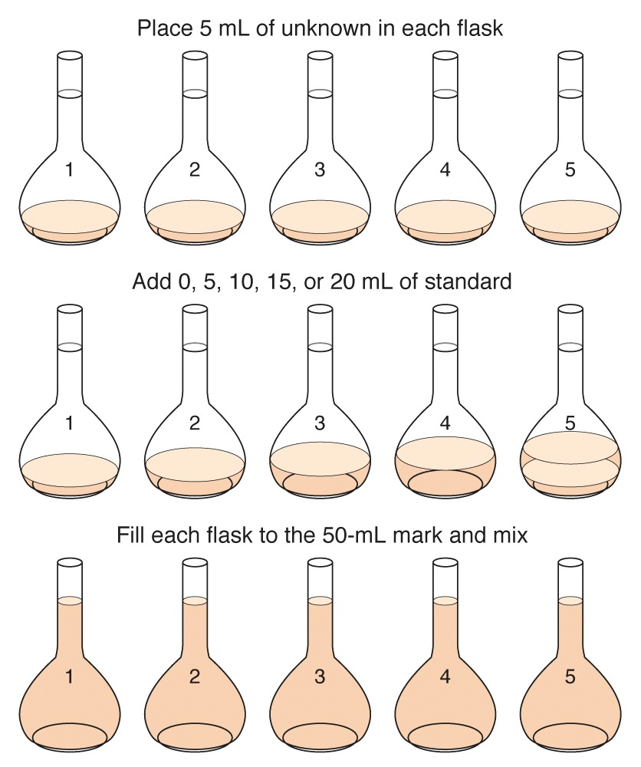
Standard addition experiment

Slide 69
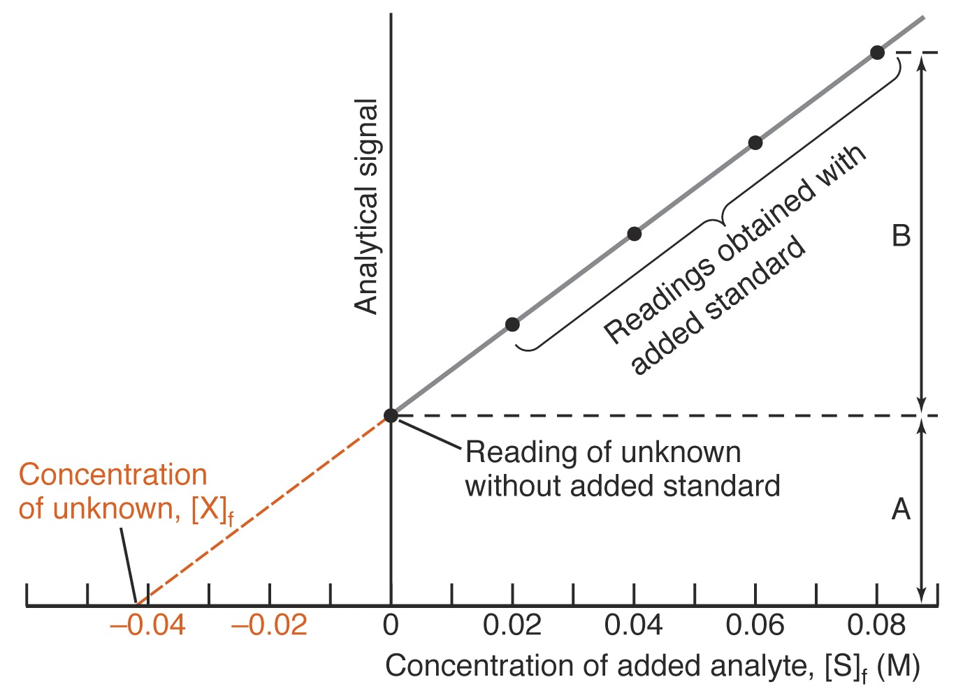
Graphical treatment of standard addition experiment.

Slide 70
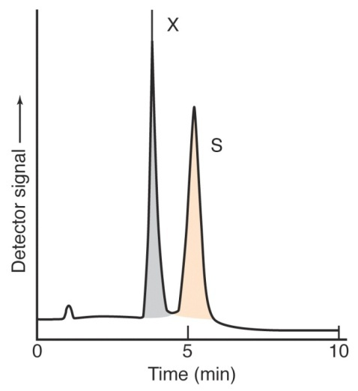
Internal standard methods
An internal standard method is a reference species, chemically and physically similar to the analyte, that is added to samples, standards, and blanks
The ratio of the response of the analyte to that of the internal standard is plotted versus the concentration of analyte
Signal
[X] / [IS]
Illustration of the internal standard method

Slide 71
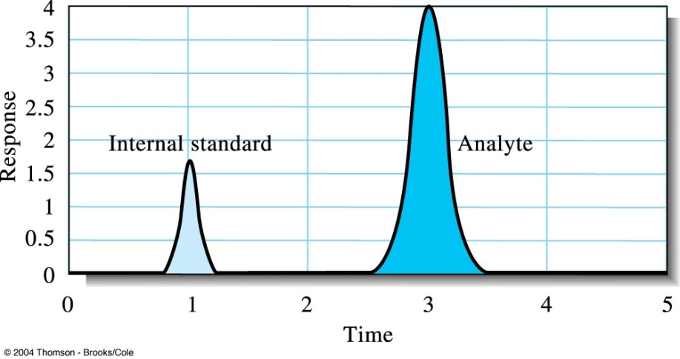
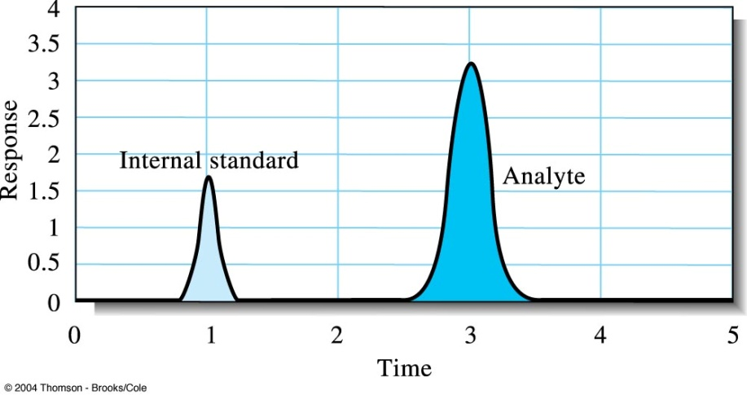
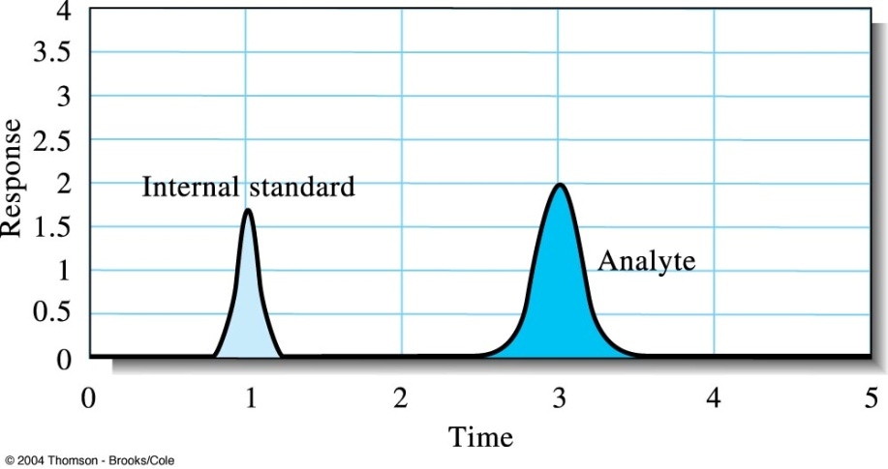
Illustration of the internal standard method.

Slide 72
Gravimetric Methods of Analysis

Slide 73
Gravimetry
Gravimetric methods are quantitative methods that are based on determining the mass of pure compound to which the analyte is chemically related.
Precipitation gravimetry: the analyte is separated from a solution of the sample as a precipitate and is converted to a compound of known composition that can be weighed. The precipitant is a reagent that causes the precipitation of a soluble species.
Volatilization gravimetry: the analyte is separated from other constituents of a sample by conversion to a gas of known chemical composition. The weight of this gas then serves as a measure of the analyte concentration.

Slide 74
Gravimetry
Electrogravimetry: the analyte is separated by deposition on an electrode by electrical current. The mass of this product then provides a measure of the analyte concentration.
Atomic mass spectrometry: use a mass spectrometer to separate the gaseous ions formed from the elements making up a sample of matter. The concentration of the resulting ions is then determined by measuring the electrical current produced when they fall on the surface of an ion detector.

Slide 75
Procedure for gravimetry based on precipitation
1) Preparation of sample solution
2) Precipitation : Gravimetric precipitating agent should react specifically or at least selectively with the analyte.
rR + aA = R_{r}A_{a} (solid)
3) Digestion
4) Filtration and washing
5) Drying, ignition and weighing
6) Computation of results

Slide 76
Ex. Precipitation method for determining calcium in natural water
2NH₃ + H₂(COO)₂ → 2NH₄⁺ + (COO)₂^{2–}
Ca²⁺ + (COO)₂^{2–} → Ca(COO)₂ (s)
Ca(COO)₂ (s) → CaO (s) + CO (g) + CO₂ (g)
Δ

Slide 77
Examples of gravimetry
Ag⁺ + Cl– = AgCl
[Cl – ] = ?
Ag⁺ + Cl– = AgCl
1 mol 1 mol 1 mol = 143.321g
x x mol = 0.4368g
x = 3.048 ×10^{–3}mol
[Cl– ] = 3.048 ×10^{–3} mol / 10.00ml
= 0.3048 M
Excess AgNO₃
AgCl
0.4368 g
10.00 ml Cl–

Slide 78
Properties of Precipitates and Precipitating Reagents
Requirements of the ideal product of a gravimetry :
1) very insoluble
2) easily filterable : large crystal particle
3) very pure
4) known and constant composition

Slide 79
Solubility effects
An accurate precipitation gravimetric method requires
that the precipitate’s solubility be minimal
Many total analysis techniques can routinely
be performed with an accuracy of better than ±0.1%
To obtain a high level of accuracy, the isolated precipitate must account for at least 99.9% of the analyte.

Slide 80
Solubility effects
Solubility losses are minimized by carefully controlling the composition of the solution in which the precipitate forms
This requires an understanding of the relevant equilibrium reactions affecting the precipitate’s solubility
For example, Ag+ can be determined gravimetrically by adding Cl– as a precipitant, forming a precipitate of AgCl
Ag⁺(aq) + Cl–(aq) AgCl(s)

Slide 81
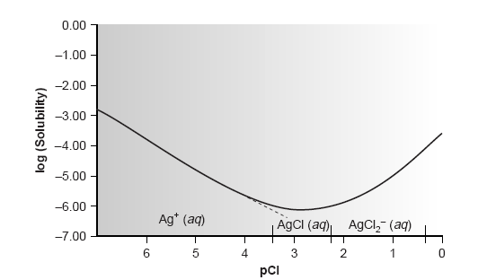
Solubility effects
Clearly the equilibrium concentration of chloride is an important parameter if the concentration of silver is to be determined gravimetrically by precipitating AgCl. In
particular, a large excess of chloride must be avoided.

Slide 82
Effect of pH
Another important parameter that may affect a precipitate’s solubility is the pH of the solution in which the precipitate forms
For example, hydroxide precipitates, such as Fe(OH)₃, are more soluble at lower pH levels at which the concentration of OH– is small.
The effect of pH on solubility but also affects precipitates containing basic or acidic ions

Slide 83
pH of solution
The solubility of Ca₃(PO₄)₂ is pH-dependent because phosphate is a weak base. The following four reactions, therefore, govern the solubility of Ca₃(PO₄)₂.
Ca₃(PO₄)₂(s) 3Ca²⁺(aq) + 2PO₄^{3–}(aq)
PO₄^{3–}(aq) + H₂O(l) HPO₄^{2–}(aq) + OH–(aq)
HPO₄ ^{2–}(aq) + H₂O(l) H₂PO₄–(aq) + OH–(aq)
H₂PO₄–(aq) + H₂O(l) H₃PO₄(aq) + OH–(aq)
Depending on the solution’s pH, the predominant phosphate species is either PO₄^{3–},HPO₄ ^{2–}, H₂PO₄–, or H₃PO₄

Slide 84
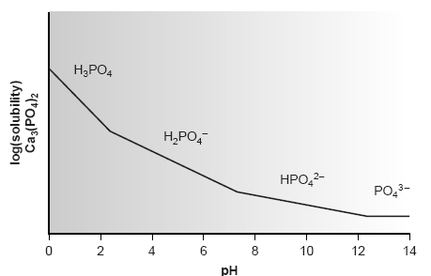
Solubility diagram for Ca₃(PO₄)₂ showing the predominant form of phosphate for each segment of the solubility curve.

Slide 85
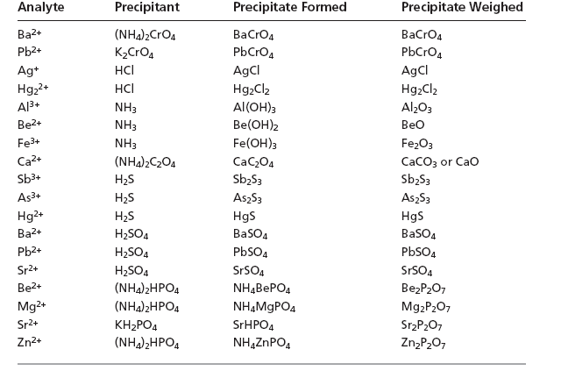

Slide 86
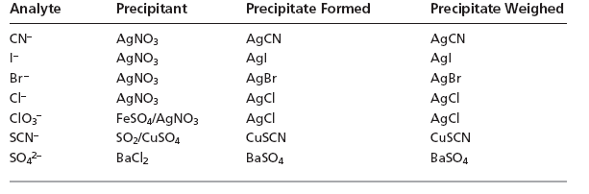

Slide 87
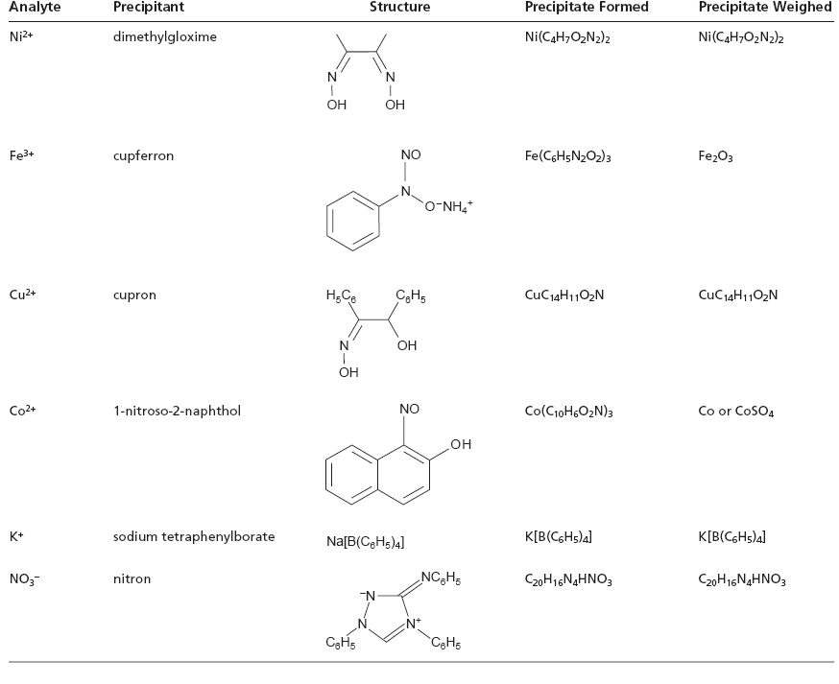

Slide 88
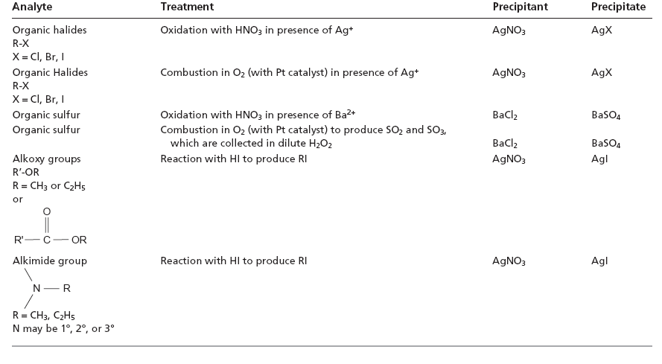

Slide 89
Solvent Effect
Solubility can often be decreased by using a nonaqueous solvent.
A precipitate’s solubility is generally greater in aqueous solutions because of the ability of water molecules to stabilize ions through solvation.
The poorer solvating ability of nonaqueous solvents, even those that are polar, leads to a smaller solubility
product.
For example, PbSO₄ has a Ksp of 1.6 x10^{–8} in H₂O, whereas in a 50:50 mixture of H₂O/ethanol the K_{sp} at 2.6 x 10^{–12} is four orders of magnitude smaller

Slide 90
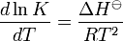
Solubility of precipitate
ΔH<0
T ↓ ⇒ solubility ↓
Vant Hoff equation
Polarity of solvent ↓ ⇒ solubility ↓
log Ks
ΔH>0
1/T
Hexane CCl₄ Benzene Toluene CHCl₃ Pyridine HAC Acetone EtOH MtOH CH₃CN Water
Non-polar
Polar

Slide 91
Filterability : large particle size
Precipitation mechanism
1) Induction period (few min) : A precipitant (counterion) is added
2) Nucleation : form small aggregates
3) Particle growth to form larger crystal
4) Adsorption
5) Electrostatic attraction to coalesce : electric double layer

Slide 92
Filtration
The size of the precipitate’s particles determines the ease and success of filtration.
A solute’s relative supersaturation, RSS, can be expressed as
where Q is the solute’s actual concentration, S is the solute’s expected concentration at equilibrium, and
Q – S is a measure of the solute’s super-saturation when precipitation begins.

Slide 93
Filtration
A large, positive value of RSS indicates that a solution is highly supersaturated.
Such solutions are unstable and show high rates of nucleation, producing a precipitate consisting of numerous small particles.
When RSS is small, precipitation is more likely to occur by particle growth than by nucleation.
Larger particles form when the rate of particle growth exceeds the rate of nucleation.

Slide 94
Control of particle size
RSS can be minimized by either decreasing the solute’s concentration or increasing the precipitate’s solubility.
Temperature
pH
Precipitation in a dilute solution of analyte
Adding the precipitant slowly with vigorous stirring

Slide 95
Practical limitations
Precipitates that are extremely insoluble, such as Fe(OH)₃ and PbS, have such small solubilities that a large RSS cannot be avoided. Such solutes inevitably form small particles.
In addition, conditions that yield a small RSS may lead to a relatively stable supersaturated solution that requires a long time to fully precipitate.

Slide 96
Colloids
Colloids are particles with diameters in the range 1-100 nm.
They are larger than molecules, but too small to precipitate.
They remain in solution indefinitely, suspended by the Brownian motion (random movement) of solvent molecules.
Colloidal particles show no tendency to settle from solution and are not easily filtered.
The particles of crystalline suspension with the dimensions on the order of tenths of a millimeter or greater tend to settle spontaneously and are easily filtered.

Slide 97
Particle size
Another method for increasing particle size is by altering the charge on the surface of particles.
When a precipitate’s particles are electrically neutral, they tend to coagulate into larger particles.
Surface adsorption of excess lattice ions, however, provides the precipitate’s particles with a net positive or negative surface charge.
Electrostatic repulsion between the particles prevents them from coagulating into larger particles.

Slide 98
Particle interaction
Consider, for instance, the precipitation of AgCl from a solution of AgNO₃, using NaCl as a precipitant.
Early in the precipitation, when NaCl is the limiting reagent, excess Ag⁺ ions chemically adsorb to the AgCl particles, forming a positively charged primary adsorption layer.
Anions in solution, in this case NO ^{3 –} and OH–, are attracted toward the surface, forming a negatively charged secondary adsorption layer that balances the surface’s positive charge.
The solution outside the secondary adsorption layer remains electrically neutral.
Coagulation cannot occur if the secondary adsorption layer is too thick because the individual particles of AgCl are unable to approach one another closely enough.

Slide 99
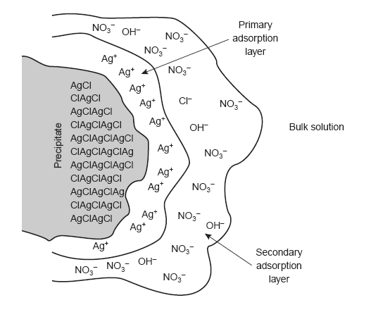
Electrical Double layer

Slide 100
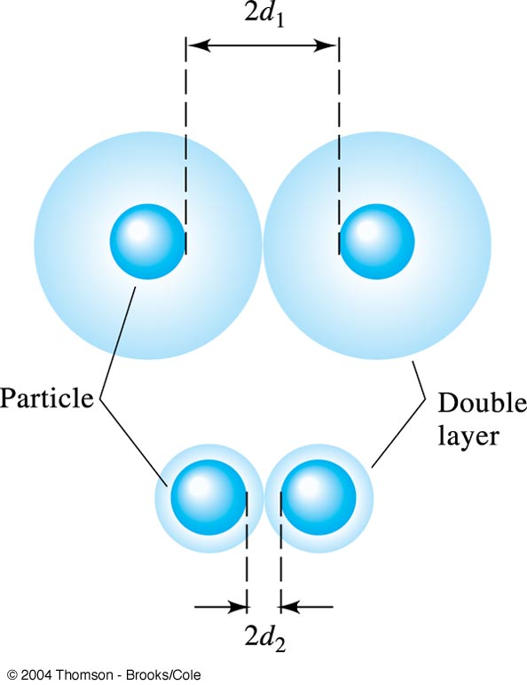
The electrical double layer of a colloid consists of a layer of charge adsorbed on the surface of the particle (the primary adsorption layer) and a layer of opposite charge (the counter-ion layer) in the solution surrounding the particle.
Increasing the electrolyte concentration has the effect of decreasing the volume of the counter-ion layer, thereby increasing the chance for coagulation.

Slide 101
Coagulation
Coagulation can be induced in two ways:
increasing the concentration of the ions responsible for the
secondary adsorption layer
(b) by heating the solution.
The addition of an inert electrolyte that increases the concentration of ions in the secondary adsorption layer.
With more ions available, the thickness of the secondary adsorption layer decreases.
Particles of precipitate may now approach one another more closely, allowing the precipitate to coagulate.
The amount of electrolyte needed to cause spontaneous coagulation is called the critical coagulation concentration.

Slide 102
Coagulation
Heating the solution and precipitate provides a second way to induce coagulation
As the temperature increases, the number of ions in the primary adsorption layer decreases, lowering the precipitate’s surface charge
In addition, increasing the particle’s kinetic energy may be sufficient to overcome the electrostatic repulsion preventing coagulation at lower temperatures

Slide 103
Treatments after precipitation
Peptization: a process by which a coagulated colloid returns to its dispersed state.
Digestion : for a period of standing with heating the precipitate in contact with its mother liquor to improve filterability of the crystalline particles.
Washing
Re-precipitation
Mother
liquor
ppt

Slide 104
Impurities of ppt
co-precipitation
1) surface adsorption
2) mixed-crystal formation: inclusions:
impurity ions that
randomly occupy
crystal lattice
3) occlusions :
pockets of impurities that are literally trapped inside the growing crystal
4) mechanical entrapment
A
B
C
D

Slide 105
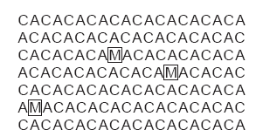
Inclusions
Potential interfering ions whose size and charge are similar to a lattice ion may substitute into the lattice structure
The interferent precipitates with the same crystal structure
The probability of forming an inclusion is greatest when the interfering ion is present at substantially higher concentrations than the dissolved lattice ion
The presence of an inclusion does not decrease the amount of analyte that precipitates
Thus, the precipitate’s mass is always larger than expected

Slide 106
Inclusions
Inclusions are difficult to remove since the included material is chemically part of the crystal lattice
The only way to remove included material is through re-precipitation
After isolating the precipitate from the supernatant solution, it is dissolved in a small portion of a suitable solvent at an elevated temperature.
The solution is then cooled to re-form the precipitate
Since the concentration ratio of interferent to analyte is lower in the new solution than in the original supernatant solution, the mass percent of included material in the precipitate decreases

Slide 107
Inclusions
This process of re-precipitation is repeated as needed to completely remove the inclusion
Potential solubility losses of the analyte, however, cannot be ignored
Thus, re-precipitation requires a precipitate of low solubility, and a solvent for which there is a significant difference in the precipitate’s solubility as a function of temperature

Slide 108
Occlusions
Occlusions occur when physically adsorbed interfering ions become trapped within the growing precipitate
The most common mechanism occurs when physically adsorbed ions are surrounded by additional precipitate before they can be desorbed or displaced
In this case the precipitate’s mass is always greater than expected
Occlusions also form when rapid precipitation traps a pocket of solution within the growing precipitate
Since the trapped solution contains dissolved solids, the precipitate’s mass normally increases.

Slide 109
Occlusions
The mass of the precipitate may be less than expected, however, if the occluded material consists primarily of the analyte in a lower-molecular-weight form from that of the precipitate
Occlusions are minimized by maintaining the precipitate in equilibrium with its supernatant solution for an extended time
This process is called digestion and may be carried out at room temperature or at an elevated temperature
During digestion, the dynamic nature of the solubility–precipitation equilibrium, in which the precipitate dissolves and re-forms, ensures that occluded material is eventually exposed to the supernatant solution
Since the rate of dissolution and re-precipitation are slow, the chance of forming new occlusions is minimal.

Slide 110
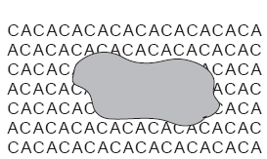
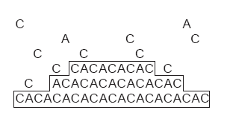

Slide 111
Other Impurities
Another source of impurities occurs when other species in solution precipitate under the conditions of the analysis.
Solution conditions necessary to minimize the solubility of a desired precipitate may lead to the formation of an additional precipitate that interferes in the analysis
For example, the precipitation of nickel dimethylgloxime requires a pH that is slightly basic. Under these conditions, however, any Fe³⁺ that might be present precipitates as Fe(OH)₃.

Slide 112
Other Impurities
Finally, since most precipitants are not selective toward a single analyte, there is always a risk that the precipitant will react, sequentially, with more than one species
The formation of these additional precipitates can usually be minimized by carefully controlling solution conditions
Interferents forming precipitates that are less soluble than the analyte may be precipitated and removed by filtration, leaving the analyte behind in solution.

Slide 113
Homogeneous Precipitation
As the precipitate forms there is steady decrease in RSS
Precipitation time increases
One solution is to chemically generate the precipitant in solution as the product of a slow chemical reaction
This maintains the RSS at an effectively constant level.
The precipitate initially forms under conditions of low RSS, leading to the nucleation of a limited number of particles.
As additional precipitant is created, nucleation is eventually superseded by particle growth.
This process is called homogeneous precipitation

Slide 114
Homogeneous Precipitation
Two general methods are used for homogeneous precipitation:
If the precipitate’s solubility is pH-dependent, then the analyte and precipitant can be mixed under conditions in which precipitation does not occur. The pH is then raised or lowered as needed by chemically generating OH– or H₃O⁺. For example, the hydrolysis of urea can be used as a source of OH–.
CO(NH₂)₂(aq) + H₂O(l) CO₂(g) + 2NH₃(aq)
NH₃(aq) + H₂O(l) NH₄⁺(aq) + OH–(aq)
The hydrolysis of urea is strongly temperature-dependent, with the rate being negligible at room temperature.
The rate of hydrolysis, and thus the rate of precipitate formation, can be controlled by adjusting the solution’s temperature.

Slide 115
Homogeneous Precipitation
In the second method of homogeneous precipitation, the precipitant itself is generated by a chemical reaction. For example, Ba²⁺ can be homogeneously precipitated as BaSO₄ by hydrolyzing sulphamic acid to produce SO₄^{2–}.
NH₂SO₃H(aq) + 2H₂O(l) NH₄⁺(aq) + H₃O⁺(aq) + SO₄^{2–}(aq)

Slide 116
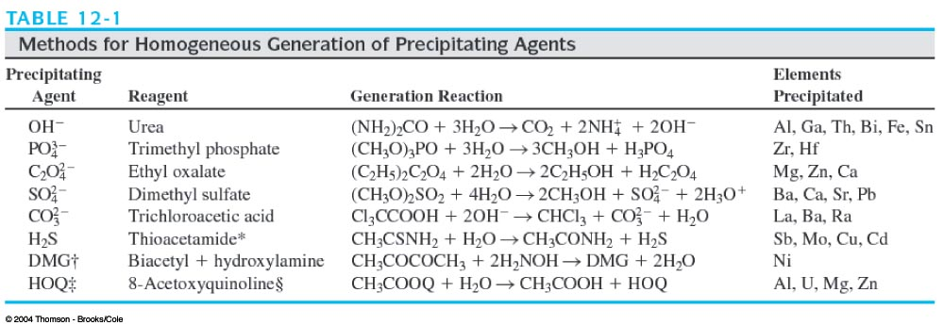

Slide 118
Example
Ex. Relating mass of product to mass of reactant
piperazine + 2 CH₃COOH → piperazine diacetate
FW 84.121 FW 60.053 FW 204.227 = 1 mol
x mol ppt 0.7121 g = x mol
y g
∴ x = 0.003487 mol y = 0.2933 g
Weight percent of piperazine in the commercial material (0.3126 g)
= (0.2933 / 0.3126)× 100 = 93.83 %

Slide 121
Combustion analysis
Combustion methods are useful for the analysis of carbon, hydrogen, nitrogen, sulfur, and halogen.
Catalyst
Pt gauze
CuO PbO₂ MnO₂
O₂
Sample in
Pt boat
Phosphorous pentoxide
NaOH
Absorb water
Absorb CO₂
Confirmation of a molecular formula is satisfactory when the
calculated and experimentally determined percentages agree within ±0.3%.

Slide 122
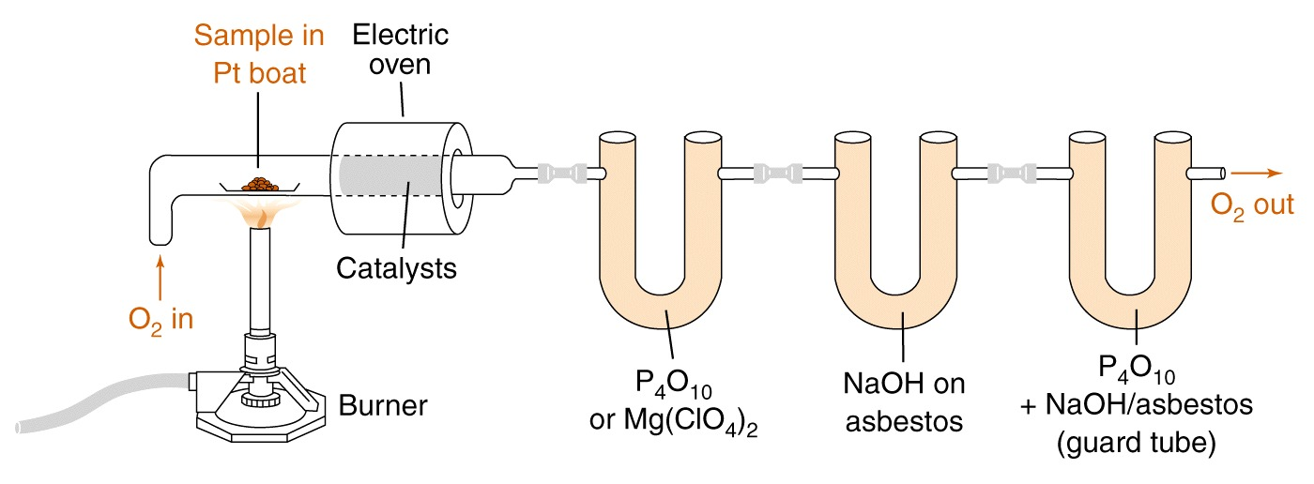
Gravimetric combustion analysis for carbon and hydrogen.

Slide 123
Example: Determination of masses of C, H by combustion analysis
Organic
compound
5.714mg
combust
CO₂ 14.414 mg
H₂O 2.529mg

